Slide 1
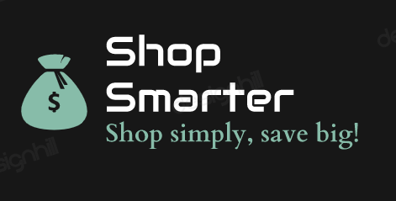
Shop
Smarter
Website

Slide 2
Abstract
Introduction
Content
Project Design
Project Analysis
Alternative Solution Analysis
Project Progress Evaluation
Future Scope

Slide 3
Abstract
The Shop Smarter is a web application that allows users to
compare multiple products based on various features and criteria.
The Website collects data on different products from various sources and presents it in a user-friendly interface that makes it easy to compare and evaluate each product

Slide 4
Introduction
Shop Smarter is a web based application which allow users to compare different types of products based on their features and select the best suited product.
The main aim of this project is to resolve the problem which is faced by the user in their daily life, so this system will help the users to book their ticket in more efficient way .

Slide 5
Project Analysis
Objective:
Provide a platform for comparing various products in a specific category.
Problem:
Customer have to visit on different websites to compare the prices, rating and many more things of a particular product.
Solution:
Shop Smarter is a platform on which customer can compare different products just by a single click.

Slide 6
Alternative Solution Analysis for Shop Smarter Website
PROBLEM STATEMENT:
The way that is being used by the customer is very old way of finding a product in a suitable range with best specifications.
Customer has to go on different websites and compare products specifications one by one .
Furthermore , customers need to find the best product having limited price, good rating and belonging to a good brand.

Slide 7
PROPOSED SOLUTION
The solution to this problem is to create an online Shop Smarter Website.
Customer can compare the products over the Internet, 24 hours a day,7days a week.
In addition, the system lets the customers find the best product of their choice on reasonable price.

Slide 8
OBJECTIVES
The main objectives of the Shop Smarter Website include:
The objective of Shop Smarter is to provide users with an easy and convenient way to compare different products based on various criteria such as price, features, quality, and customer reviews, in order to help them make informed purchasing decisions.
This system can also help businesses to analyze their products against their competitors and make improvements based on the feedback received from the users..

Slide 9


Analyzing the cost of the solution
Cost : No Cost the project is hosted on Github.
Time to Develop : 40 hours
Time to Deploy : 5minutes

Slide 10
Project Design System Overview
Mobile
Register
Laptops
Product Categories
Watches
User
login
Novels

Slide 11
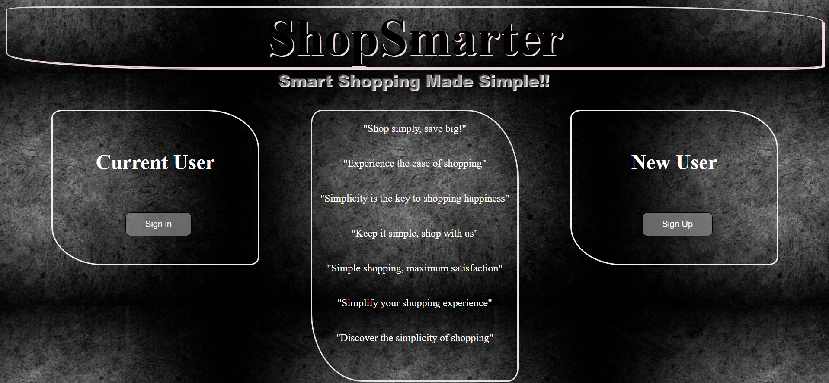
Front Page:

Slide 12
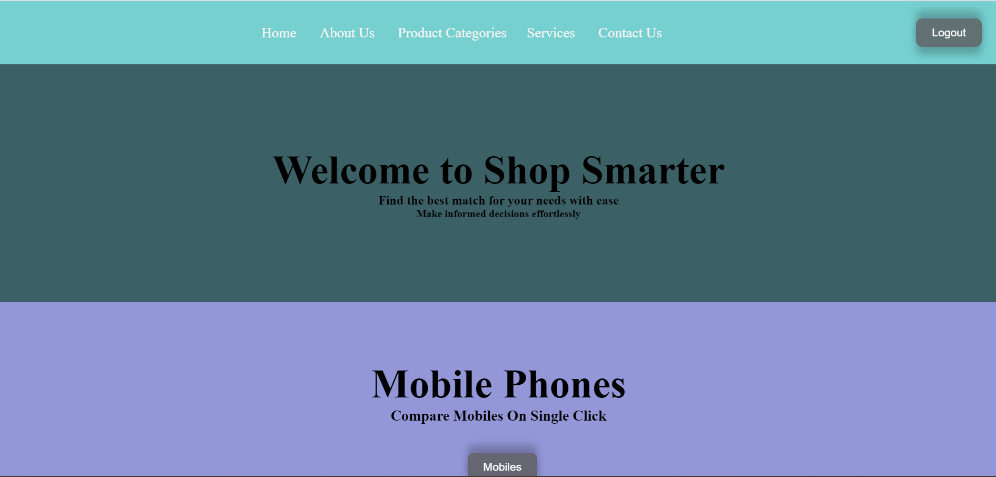
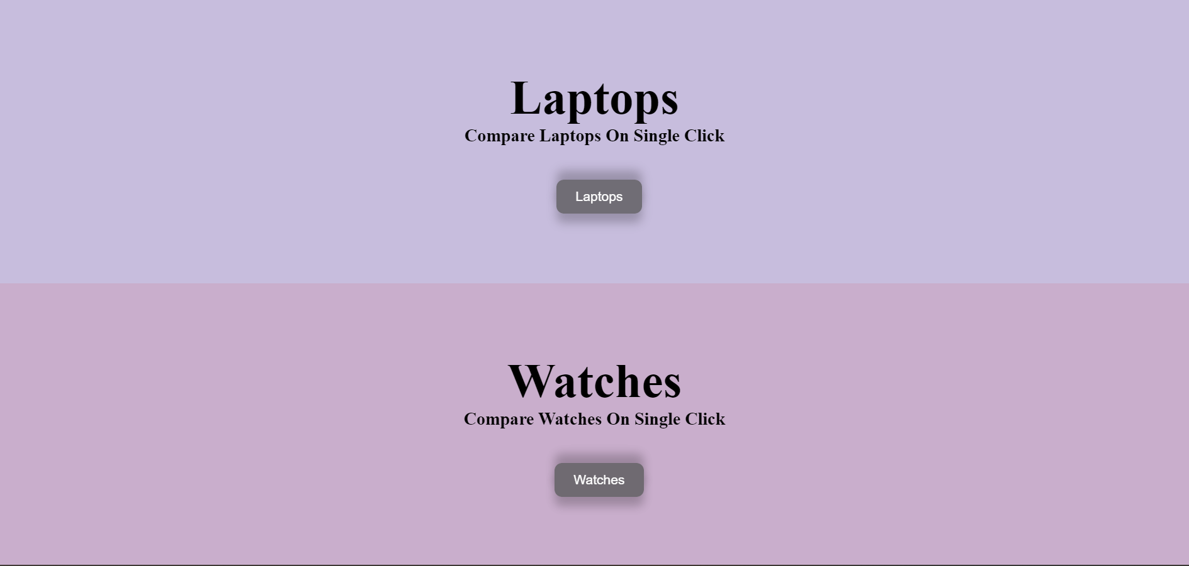
Home Page

Slide 14
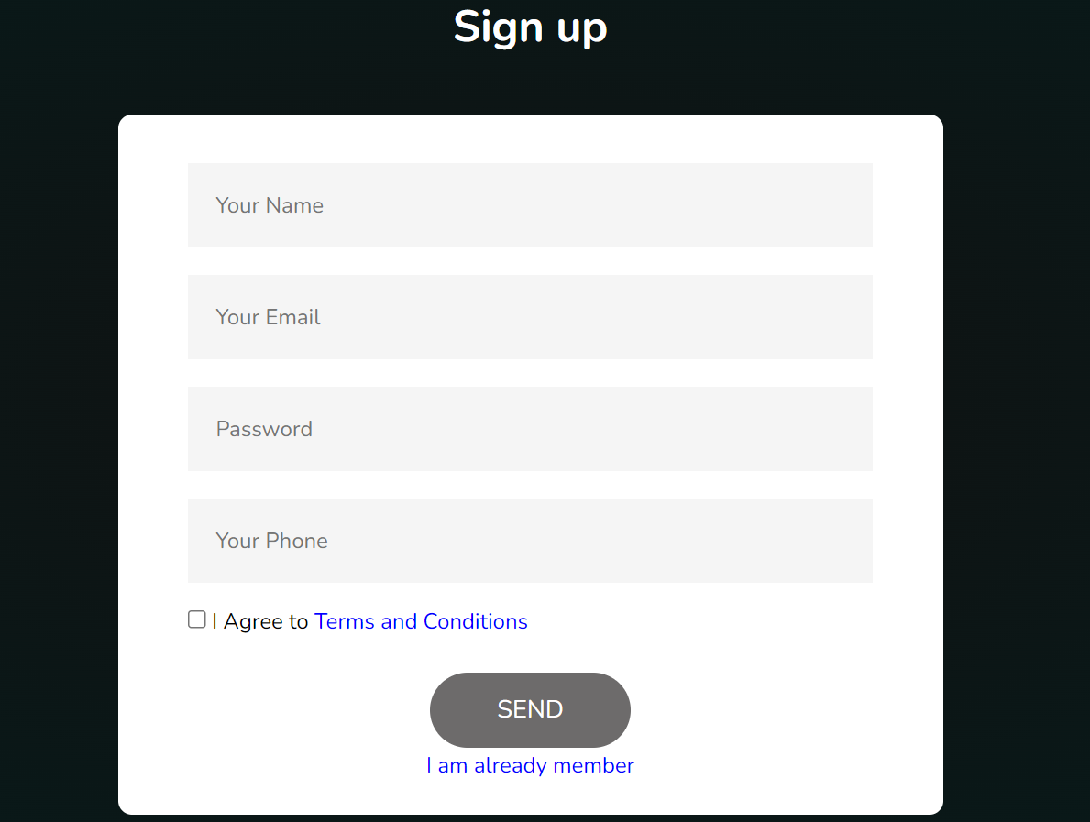
Registration Form
Any users can create an account by registering. The system will validate the user email and will reject them if they are missing or if the user email is already taken.
Customer fill all the details and clicks register.
System validates email and password fields.
System authorizes the user and create his account.
System confirms customer with email and phone authentication.
System sends confirming email to customer.

Slide 15
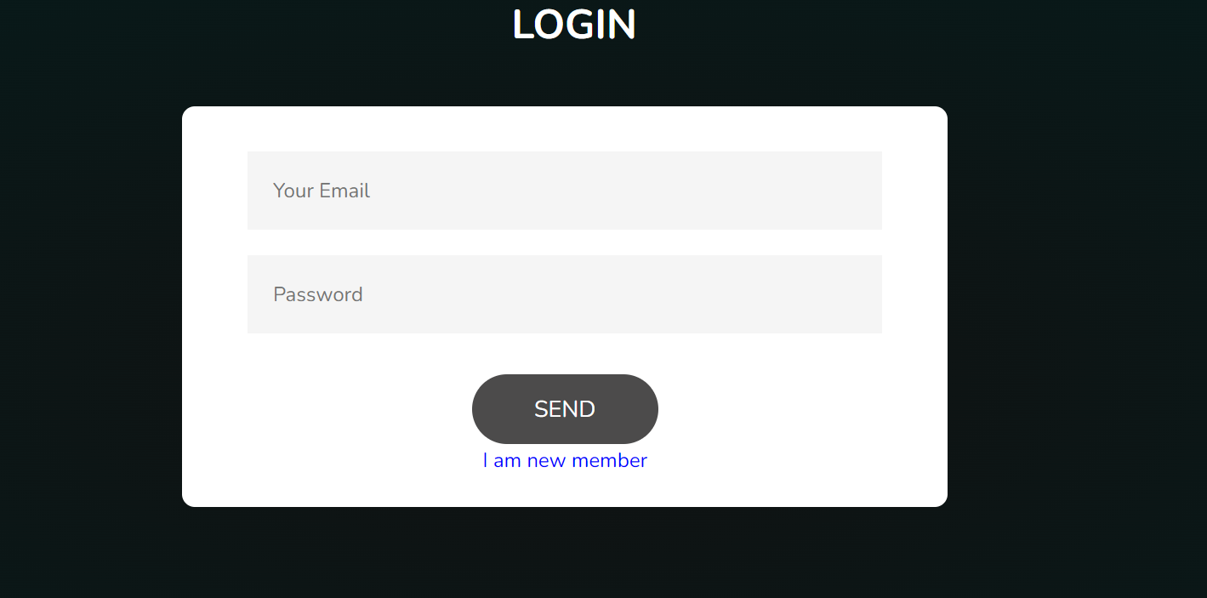
Login page
Login Page consist of username and password.
Customer have to give username and password to login.
System validates the details.

Slide 16
Product Categories:

Slide 17
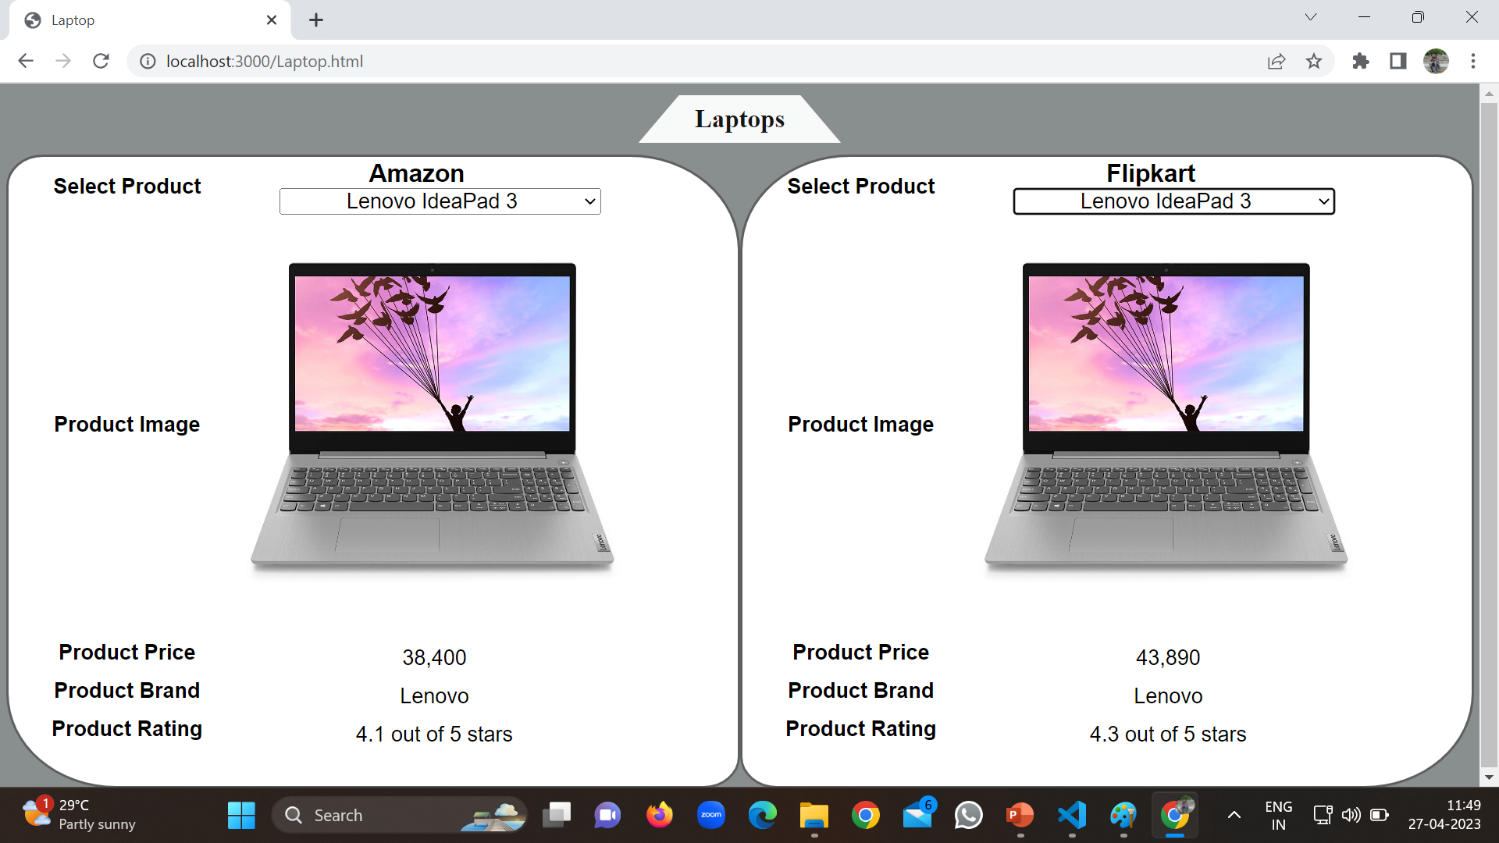

Slide 20
Programming Languages Used
HTML : HTML stands for Hypertext Mark-up Language . It used for mainly to display text code as well as formatting these texts.
CSS: CSS stand for Cascading Style sheets. This is a very powerful language for formatting the web pages and has been of great help in my project.
Angular JS: Java scripts played a very crucial role in adding some functionalities to my system . These included sliding images, a features which is much clear in the system’s homepage.
Express : is a popular and minimalist web framework for Node.js, used for building web applications and APIs..
NodeJS: Node.js is an open-source, server-side JavaScript runtime environment that allows developers to run JavaScript code on the server.
MongoDB : MongoDB is a popular NoSQL document-oriented database that provides high scalability, flexibility, and performance for modern applications.

Slide 21
Future Plans
I would like to say that this system did not capture everything that would be required and would therefore recommend for future improvement on the following:
Improved user interface and user experience
Enhanced search functionality
Integration with other platforms
Increased personalization
Incorporation of user reviews and ratings

Slide 22
Additional Future Plans
Integration of more data sources
Personalization
Improved algorithms
Mobile integration
Additional product categories

Slide 23
Conclusion
A Shop Smarter can be a valuable tool for consumers who are looking to make informed purchasing decisions
By comparing products based on specific criteria such as price, features, and customer reviews, users can quickly and easily identify the best options for their needs.
Overall, a product comparator system can be a useful resource for consumers.

Slide 24
Thank You

